Slide 1
Basic Presentation

Slide 2
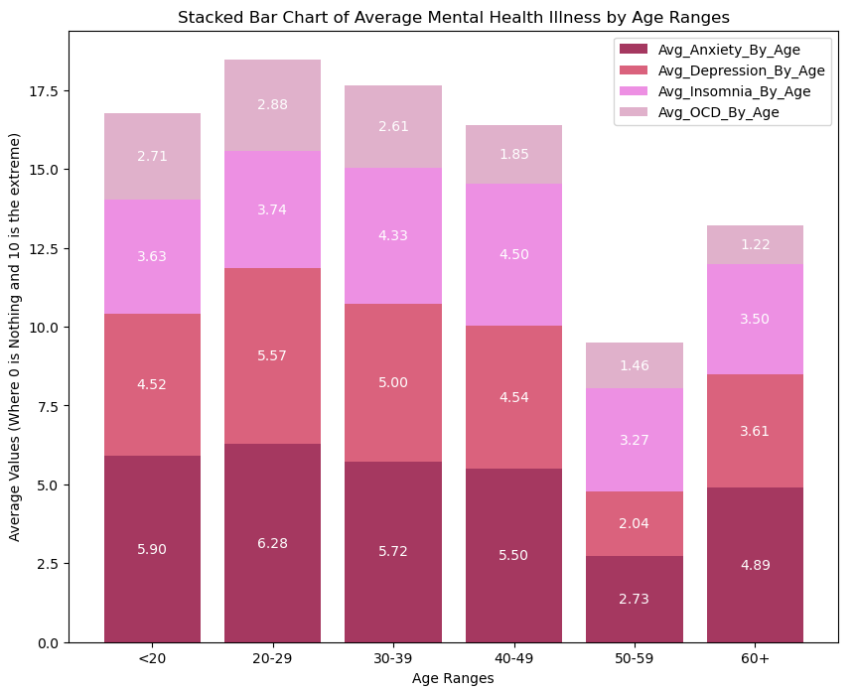
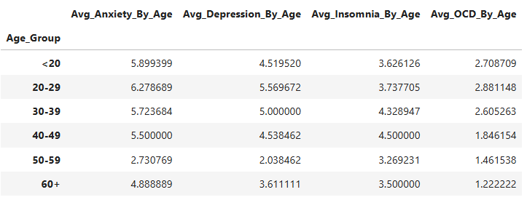
Illness Average per Age Group
The OCD (Obsessive-Compulsive Disorder), is common to begin by age 14 up to the 35.

Slide 3
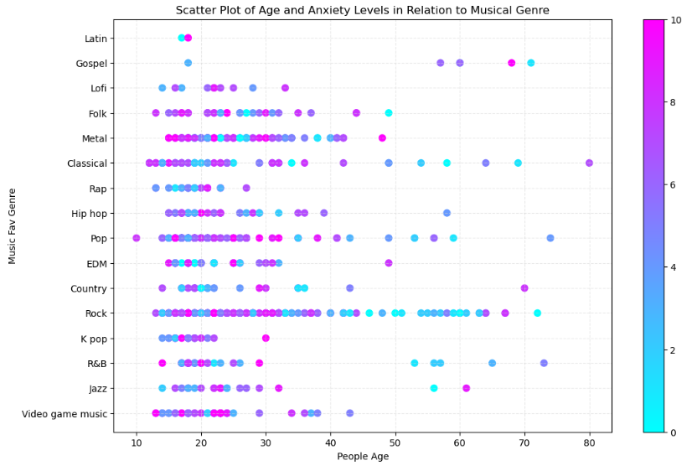
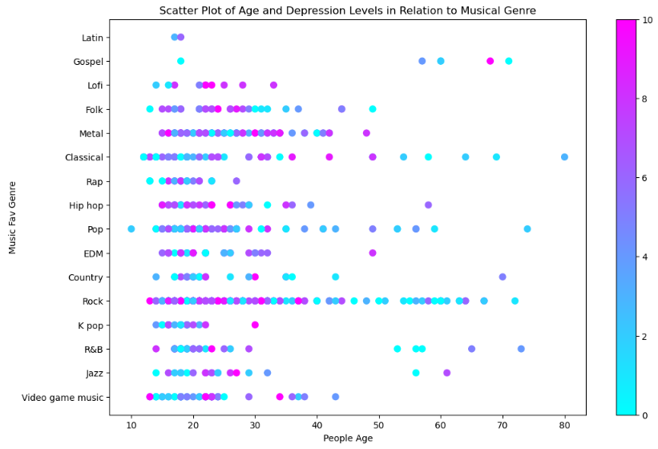

Slide 5
Obsessive-Compulsive Disorder (OCD) - Psychiatric Disorders - Merck Manual Professional Edition (merckmanuals.com)
Obsessive–compulsive disorder - Wikipedia

